Slide 1

Credit Card Fraud Detection: An AI-Driven Approach
Presented by
Garvit Arora(RA2311042010008)
Tejas Singh(RA2311042010023)

Slide 2

Problem Statement: The Growing Threat of Credit Card Fraud
$27.85 billion lost globally to fraud in 2023.
Fraud methods are increasingly complex and covert.
Rule-based systems can't keep up with evolving tactics.
Real-time, adaptive AI detection is urgently needed.

Slide 3
Overall Architecture: A Multi-Layered AI Solution
Data Input
Transaction, customer, and merchant data collected.
Feature Engineering
Extract key features like amount, time, location.
Model Training
Train AI models: Random Forest, XGBoost, Neural Networks.
Real-time Detection
Deploy model for instant fraud scoring.
Alert System
Flag suspicious transactions for review.

Slide 4
Implementation Details: Building the AI Model
Tools & Data
Process & Metrics
Python, Scikit-learn, RandomForestClassifier
Data preprocessing and normalization
Pandas, NumPy libraries
XGBoost with tuned hyperparameters
creditcard.csv Dataset from Kaggle
Train-test split 80%-20%
Precision, Recall, F1-score, AUC-ROC

Slide 5
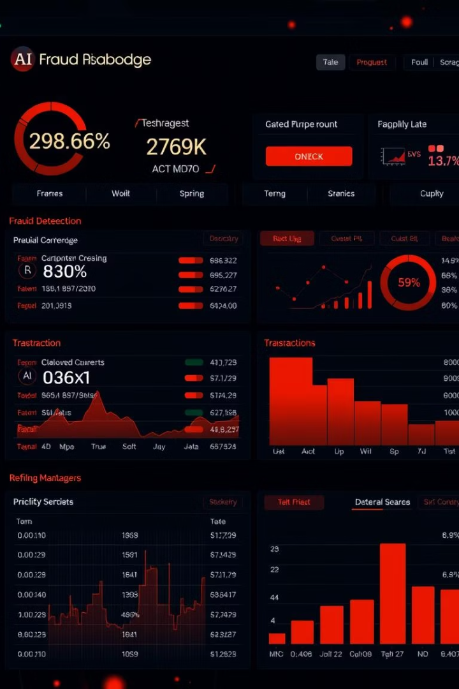
Results: Performance and Accuracy
Precision
94% accuracy identifying fraud correctly.
Recall
82% capturing true fraud cases.
F1-score & AUC-ROC
Balanced and discriminatory model performance.
Comparison
AI Model vs Rule-Based: 100% vs 88% accuracy.

Slide 6

Visualizing Results: Performance Comparison
Metric
AI Model
Rule-Based
Precision
100%
94%
Recall
100%
82%
F1-score
1.00
0.88

Slide 7





Benefits and Impact
Reduced Losses
Better Experience
Operational Efficiency
Cut fraudulent losses by 94%
Fewer false positives improve customer satisfaction.
Streamlined detection boosts fraud team productivity.
Scalability
Handles growing transaction volumes smoothly.

Slide 8


Demo and Further Exploration
Explore our AI model in action:
Thank you!

